Slide 1

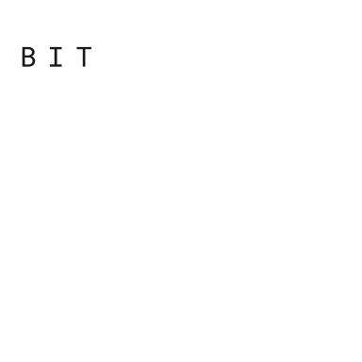
Programming
Principles
with JavaScript

Slide 2

Day Overview
Getting to Know Terminology
How Computers Work
Data Representation

Slide 3
How Computers Work

Slide 4
Computers
The three main benefits of using computers are:
Speed
Accuracy
Capacity to perform a large amount of work
Notes:
Da krenemo od toga zašto nam je potrebno da koristimo računare:
Brza obrada podataka
Tačnost pri izračunavanju podataka
Mogućnost da se velika količina podataka obradi u kratkom vremenskom periodu

Slide 5
Definition of Computer
Computer is a programmable machine
Computer is a machine that manipulates data according to a list of instructions
Computer is any device which helps humans in performing various kinds of computations or calculations

Slide 6
Definition of Computer
Three principles characteristic of a computer:
It responds to a specific set of instructions in a well- defined manner.
It can execute a pre-recorded list of instructions.
It can quickly store and retrieve large amounts of data.

Slide 7
Hardware and Software
Computer hardware includes all the electrical, mechanical, and the electronic parts of a computer.
Any part that we can see or touch is the hardware.
Notes:
Kada pričamo o računarima, obično pričamo o hardveru i softveru.

Slide 8
Hardware and Software
A set of instructions that tells the computer what to do with the input data is called a program and one or more programs is called software.

Slide 9
A Closer Look at Hardware

Slide 10
The Very Beginning
ENIAC:
weighted more than 30000 tons
2.4 x 0.9 x 30m
power consumption 150kW
20,000 vacuum tubes, 72,000 crystal diodes, 1500 relays, 70,000 resistors, 10,000 capacitors...
Notes:
ENIAC, mašina koja se smatra jednim od prvih računara, bila je vrlo kompleksna u svakom smislu.

Slide 11
State of the Art Computers
Display: 2304x1440 resolution at 226 pixels per inch with support for millions of colors
Processor: Intel Core i7, Turbo Boost up to 3.66GHz with 4MB L3 cache
Storage: 256GB storage RAM
Dimensions: 28.05 x 19.65 x 1.31cm
Weight: 0.92kg

Slide 12
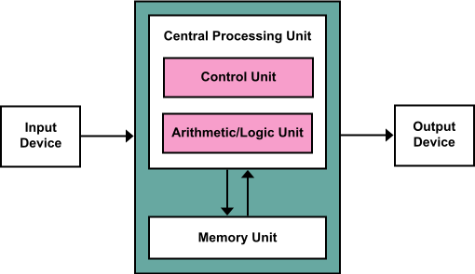
Von Neumann Architecture Scheme

Slide 13
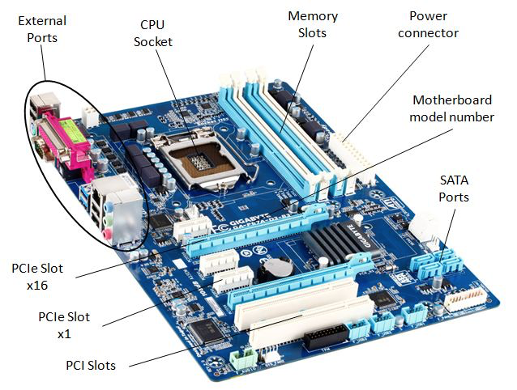

Slide 14
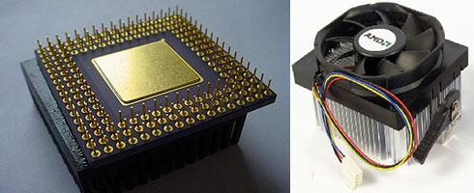
CPU
Fetch, Decode, Execute
MIPS and MFLOPS
32-bit, 64-bit
Notes:
CPU - Central Processing Unit - inevitably referred to as the "brains" of the computer. The CPU does the active "running" of code, manipulating data, while the other components have a more passive role, such as storing data. When we say that a computer can "add two numbers, a billion times a second", we mean that the CPU does it. When you hit the Run button, the CPU ultimately "runs" your code. Later on, we will complete the picture of how your JavaScript code is run by the CPU.

Slide 15
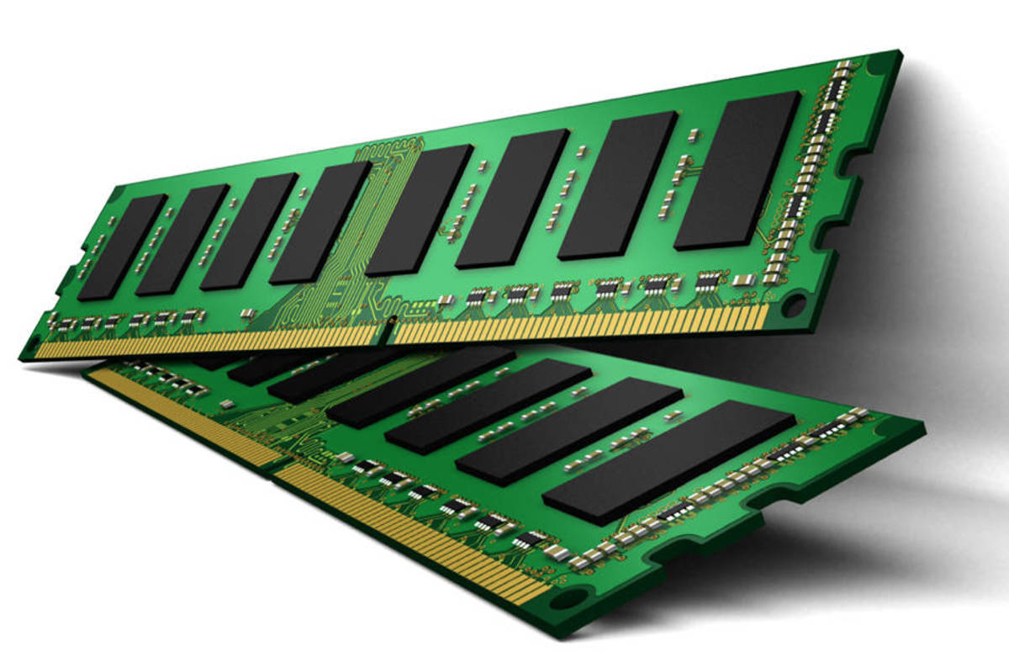
Memory
ROM - Read-Only Memory
RAM - Random-Access Memory
Cache - small fast memory
Notes:
RAM - Random-Access Memory, or just "memory". RAM is the working scratchpad memory the computer uses to store code and data that are being actively used. RAM is effectively a storage area of bytes under the control of the CPU. RAM is relatively fast, able to retrieve the value of any particular byte in a few nanoseconds (1 nanosecond is 1 billionth of a second). The other main feature of RAM is that it only keeps its state so long as it is supplied with power -- RAM is "volatile", not "persistent".
Suppose you are working on your computer and it suddenly loses power and the screen goes blank. You understand that what you were working on is gone .. RAM has been wiped clean, leaving you only with what you last saved to disk (below).
Cache - A computer’s CPU is a fast device. But the storage devices are not as fast as the CPU. Most of the time the CPU has to slow down because of these devices. A small section of the high speed RAM is used to keep frequently needed information.
Kako bi sve komponente znale da kao da komuniciraju medjusobno proizvodjaci su morali da da im daju neke nacine
One set of instructions found in the ROM is called the ROM - BIOS which stands for Read Only Memory Basic Input Output Services. This set of programs perform the most basic control and supervisory operations for the computer.

Slide 16
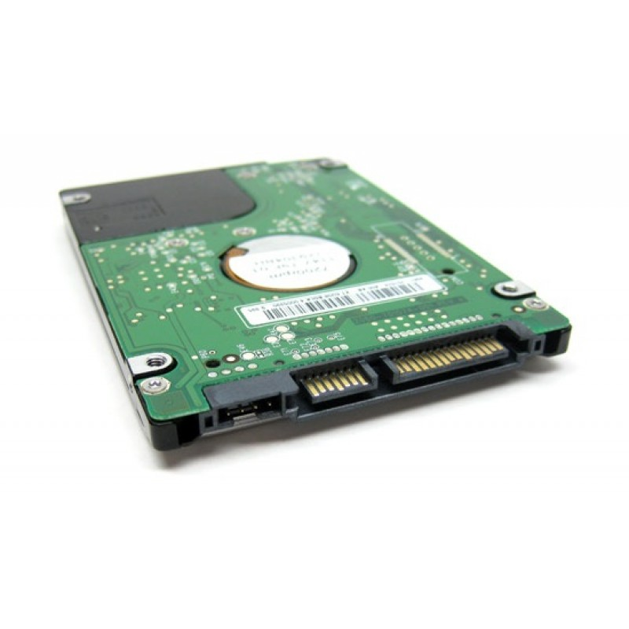
Hard Drive
Computers rely on hard disk drives (HDDS) to store data permanently. They are storage devices used to save and retrieve digital information
Notes:
Persistent storage - long term storage for bytes as files and folders. Persistent meaning that the bytes are stored, even when power is turned off. A laptop might use a spinning hard drive (also known as "hard disk") for persistent storage of files. Or it could use a "flash drive", also known as a Solid State Disk - SSD, to store bytes on flash chips. The hard drive reads and writes magnetic patterns on a spinning metal disk to store the bytes, while flash is "solid state" - there are no moving parts, just silicon chips with tiny groups of electrons to store the bytes. In either case, the storage is persistent, meaning that it maintains its state even when the power is turned off.
A flash drive is faster and uses less power than a hard disk. However, per byte, flash is significantly more expensive than hard drive storage. Flash has been getting cheaper, so it may take over niches at the expense of hard drives. Flash is much slower than RAM, so it is not a good replacement for RAM. Note that Adobe "flash" is an unrelated concept; it is a proprietary media format.
Flash storage is what underlies USB thumb drives, cameras’ SD cards, or the built-in storage in a tablet or phone.

Slide 17
Hard Drive
Currently, we can group hard drives into four types:
Parallel Advanced Technology Attachment (PATA)
Serial ATA (SATA)
Small Computer System Interface (SCSI)
Solid State Drives (SSD)

Slide 18
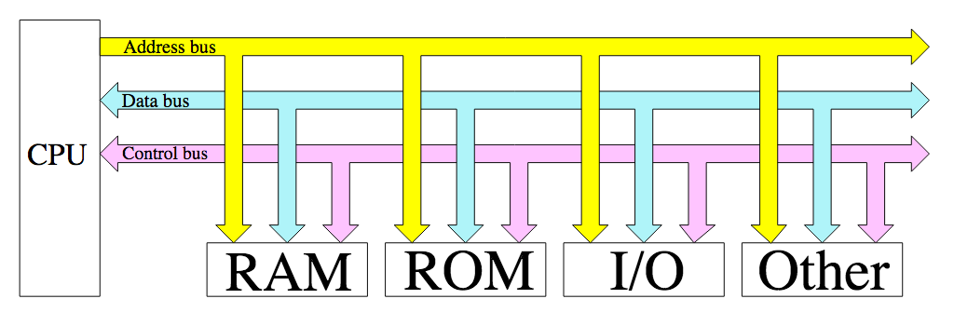
BUS
Communication path for exchanging data between components
Data bus
Address bus
Control bus

Slide 19
Slots and Ports
Controllers
Drivers
USB

Slide 20
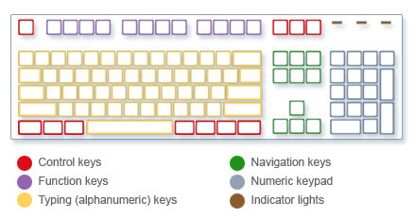
Keyboard

Slide 21
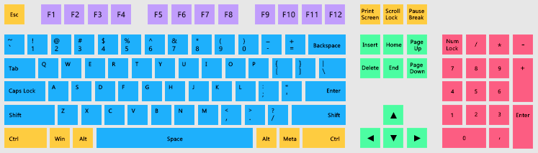
Keyboard

Slide 22
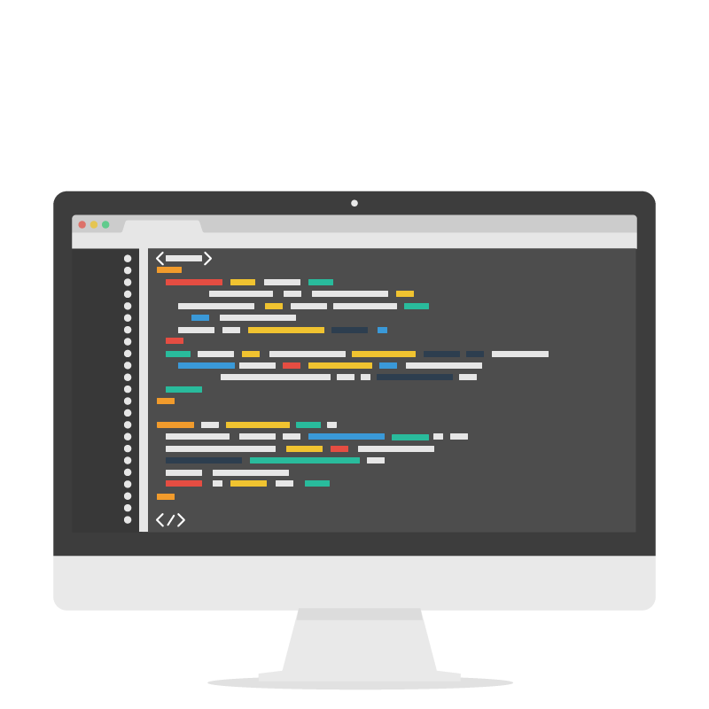
Monitor
CRT (Cathode Ray Tube)
LCD (Liquid Crystal Display)
LED (Light Emitting Diode)
Plasma
OLED (Organic Light Emitting Diode )

Slide 23
A Closer Look at Software

Slide 24
Software Classification
System software
operating systems
drivers
utility programs
Application software
Notes:
Klasifikacija softvera se moze izvršiti na mnogo načina: po tipu zadataka kojima je namenjen, po platformama na kojima se izvršava... Ovde je data opšta klasifikacija.

Slide 25
Computer Program
A computer program is a set of steps that should be taken in order to solve the problem at hand.
Notes:
Program je skup instrukcija koje vode ka rešenju problema. Analogija koja može da se napravi: kulinarski recepti.

Slide 26
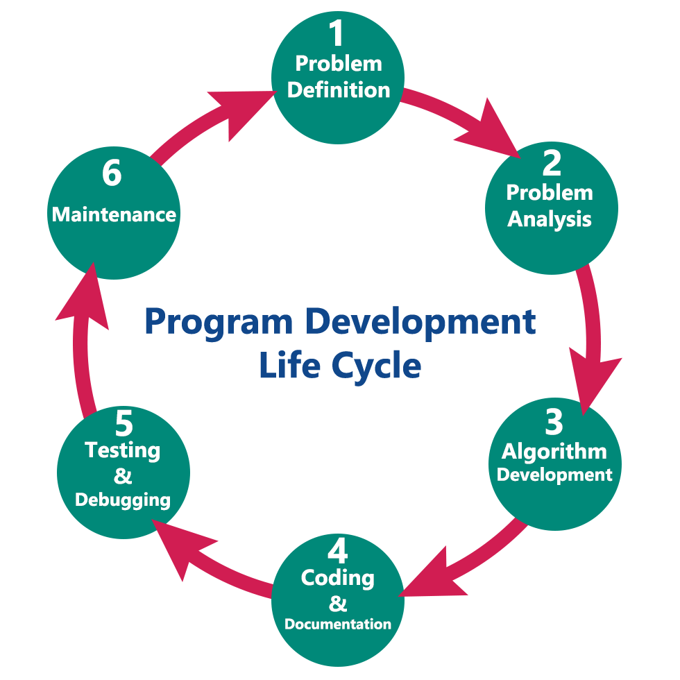
Life Cycle of a Program
Problem analysis
Coding
Compile program/interpret program
Run program
Debug it
Test it
Use it

Slide 27
Problem Analysis
What is the problem we want to solve?
What is the knowledge we can rely on?
What should be the output?

Slide 28
Problem
Sort the sequence 3, 1, 11, 8, 6
Notes:
Zamislimo da imamo 5 postova i da oni redom imaju 3, 1, 11, 8, 6 lajkova. Zadatak je da prikažemo nekom novom korisniku postove od najzanimljivijih ka manje zanimljivima. Kako to da uradimo?
I način: selection sort
II nacin: bubble sort
Poenta je da smo videli dva različita načina, dva različita algoritma, da rešimo jedan te isti problem. Algoritam je postupak, niz koraka koje treba preduzeti da bi se rešio neki problem. Algoritmi se razlikuju po svojoj efikasnosti, koliko prostora zauzimaju, koliko im vremena treba za izvršavanje, i razmatraju se različite česte probleme: algoritmi kriptovanja podataka, algoritmi kompresije podataka, algoritam trgovačkog putnika…

Slide 29
Programming Languages
Programming languages are languages we can use to write computer programs.
Just to name a few: C, C++, Java, Python, JavaScript, PHP, Go, Haskell, Prolog...
Notes:
Kako pišemo programe?
Analogija koja može da se napravi sa govornim, prirodnim jezicima.

Slide 30
Classification of Programming Languages
Low-level
Imagine yourself writing all your code using only 0’s and 1’s
High-level
Imagine yourself writing all your code in English
Notes:
Pitanje izbora odgovarajuceg jezika:
Svaki jezik ima svoje karakteristike. Prirodno se srodni jezici mogu grupisati. Kriterijumi grupisanja uticu na njihove podele. Sa stanovista udobnosti programiranja i nezavisnosti od samih platformi, moze da se posmatra podela na jezike niskog i visokog nivoa.

Slide 31
Editors and IDEs
An editor is a program that enables you to create a text file and save its content.
Integrated Development Environments are programs that extend the functionalities of editors and enhance comfort and productivity.
Notes:
Šta nam je tehnički neophodno da napišemo neki program?
Editori: Programi koji omogućavaju da se zapiše sam tekst programa.
Na primer, Notepad, gedit, Sublime, Atom…
IDE: Programi koji omogućavaju udobniji razvoj.
Na primer, Visual Code Studio, WebStorm...

Slide 32
Compilers and Interpreters
Programs we use to transform our programs into a set of instructions that CPU can understand are called compilers and interpreters. Interpreters are designed for interactive usage, while compilers follow a do-it-once paradigm.

Slide 33
Compilers and Interpreters
This step may produce errors:
we have typo in the code
we have syntax error
we use wrong version of the particular library
...

Slide 34
Program Execution
When we execute a program, we load it into computer’s memory and let the CPU do the rest.
Many IDE’s provide run functionality.

Slide 35
Debugging
It might happen that a program won’t work very well.
Debugging is a process of finding bugs in our programs.
It is good to remember: Programmers spend most of their time on debugging their own codes.
Notes:
Ovde je akcenat na logičkim greškama. Debageri su programi koji omogućavaju da ispratimo tok izvršavanja programa i korigujemo logičke previde.

Slide 36
Testing
Testing is a process of assessing program’s functionalities by various criteria: scalability, performance, security...

Slide 37
Going Back to the Starting Point
Never forget that the programs we develop are used by other people. We should care about their experience. Actually, we should always aim to design a positive user experience.

Slide 38
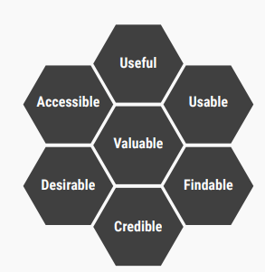
User Experience Design
Usefulness
Usability
Findability
Credibility
Desirability
Accessibility
Value

Slide 39

Exercise
Notes:
Starting with the bootcamp
Hoping to catch the wave and achieve much more

Slide 40


